Slide 1



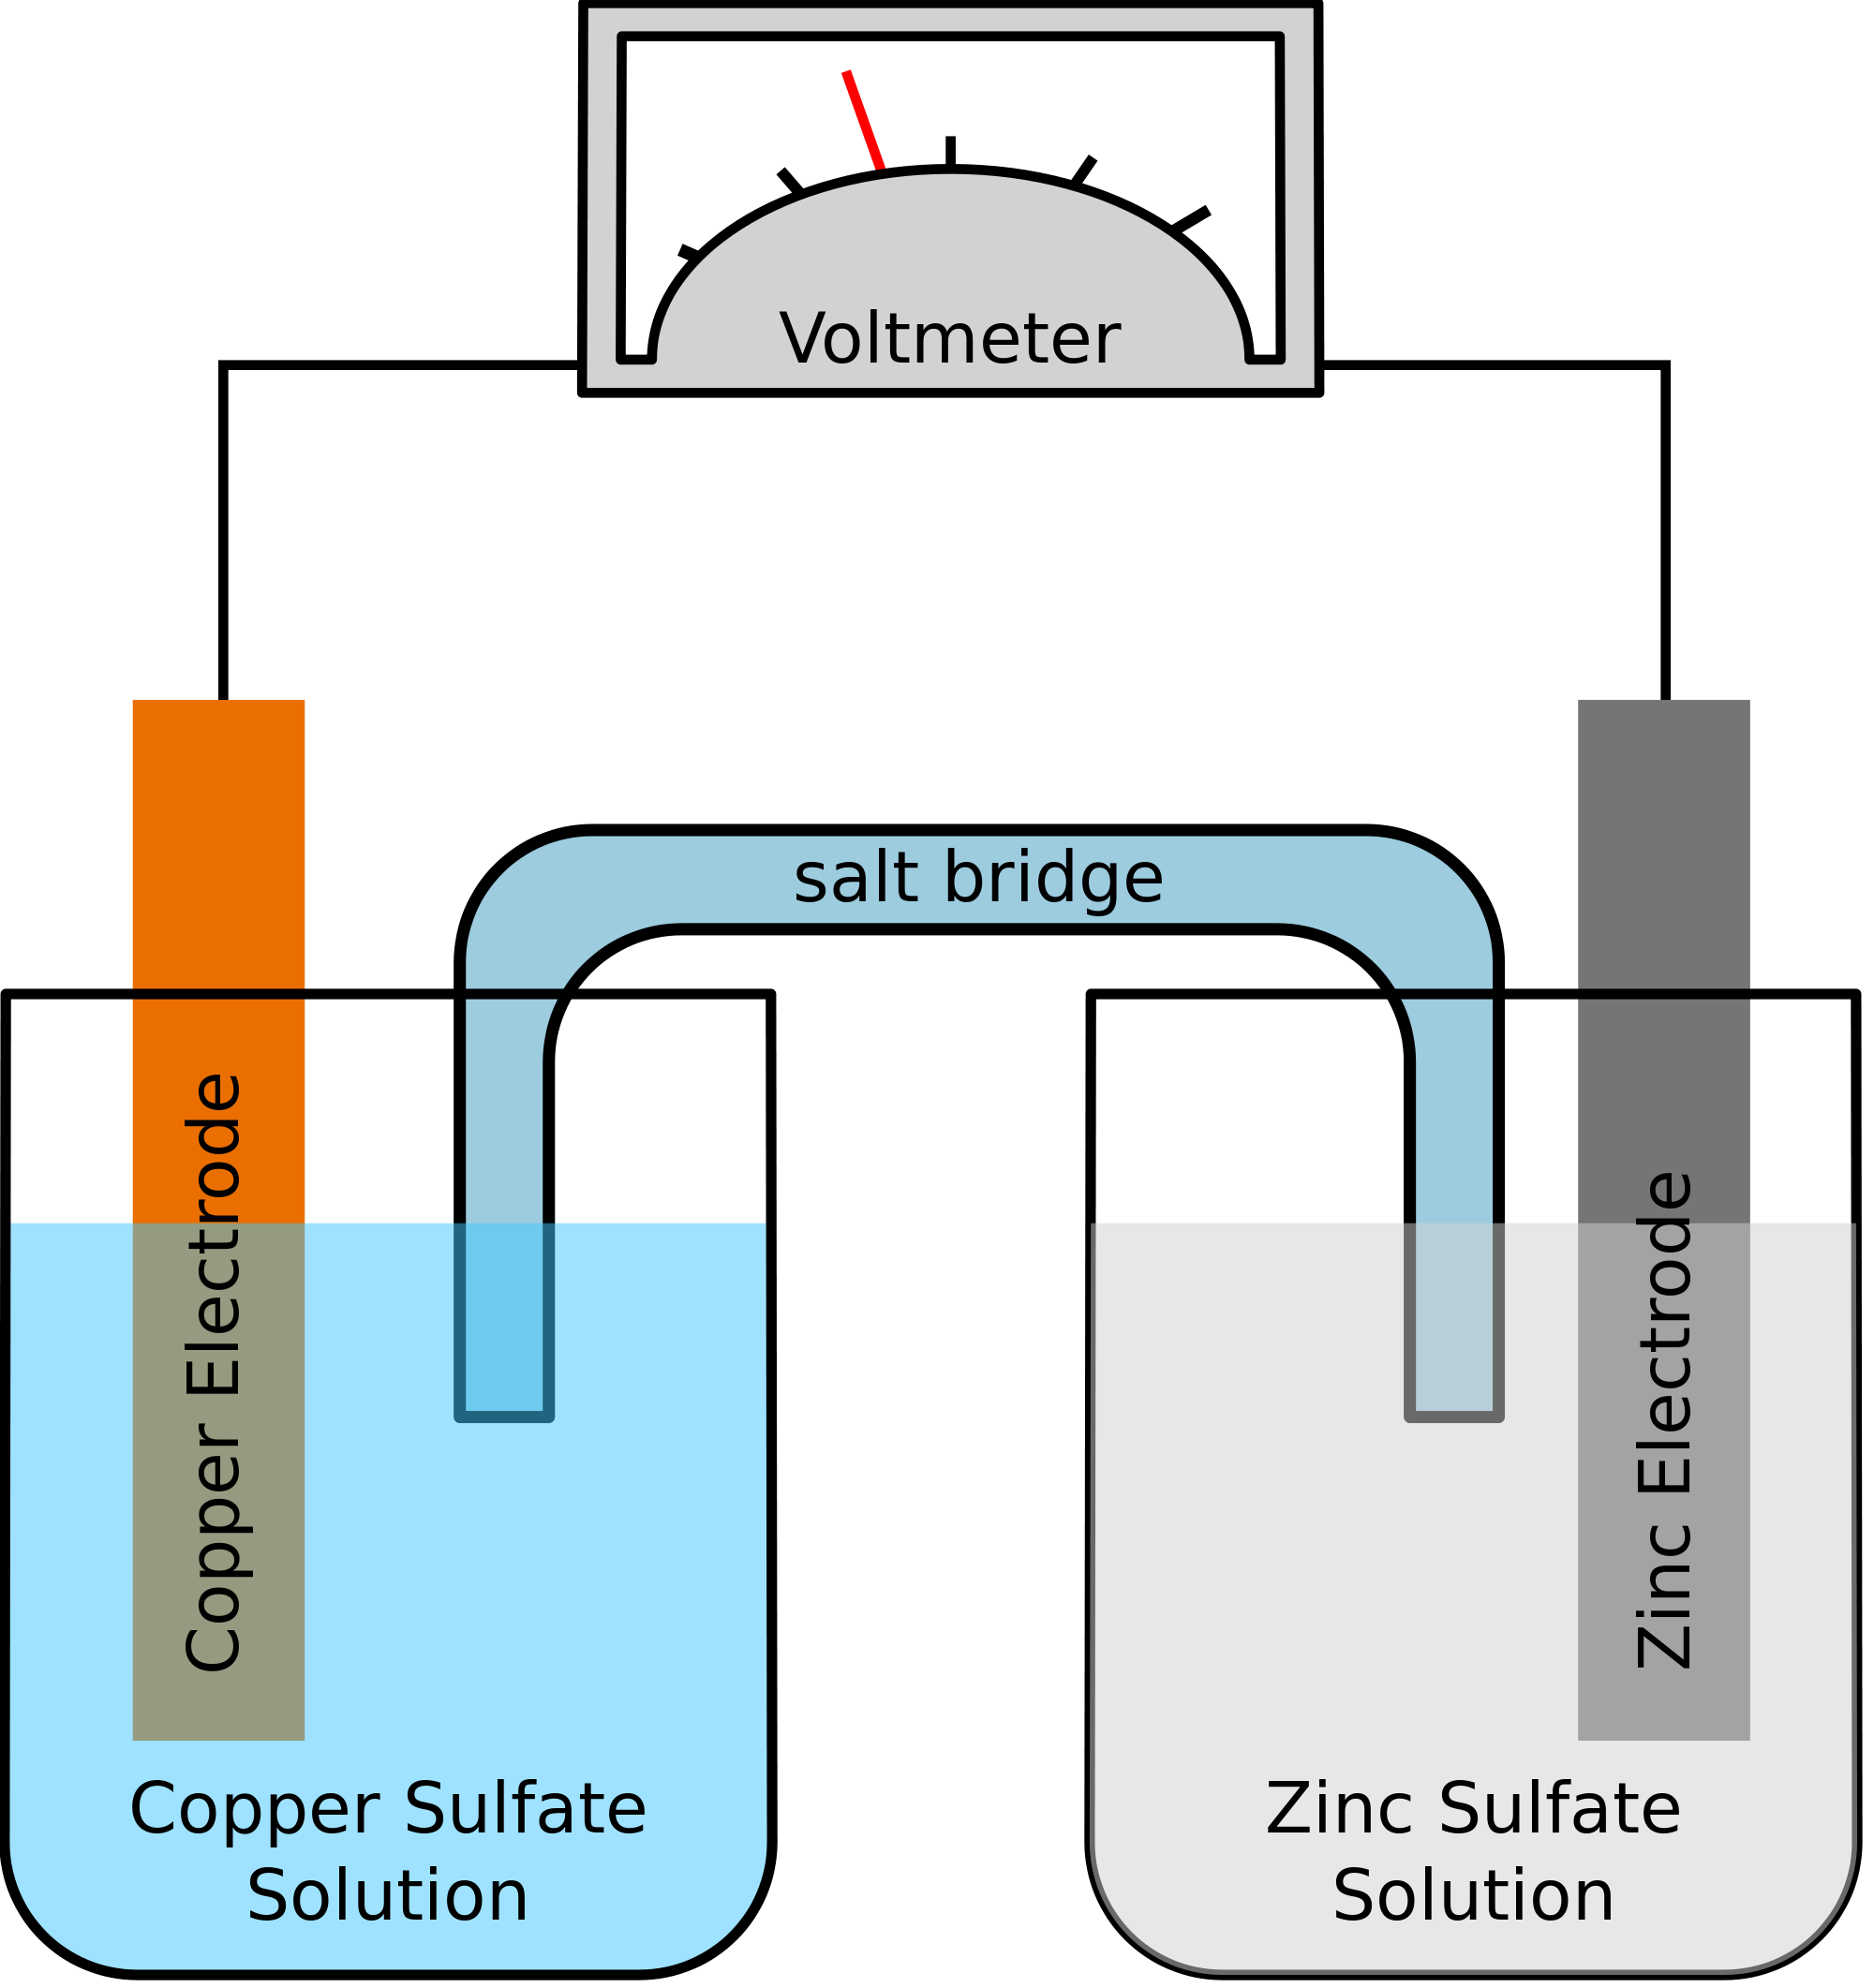
The
Galvanic cell

Slide 2

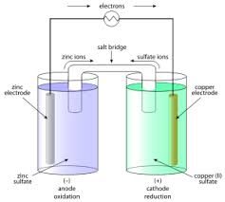
Index:
What is a galvanic cell
Components
What happens inside the cell
Uses
Differences between A Galvanic and Electrolytic cell
Topic
Galvanic Cell Members
Shruthi & Ritika

Slide 3

Galvanic (voltaic) cell
• A device in which a spontaneous redox reaction occurs as electrons are transferred from the reductant to the oxidant through an external circuit
• used to perform electrical work using the energy released during a spontaneous redox reaction.

Slide 4
Components:
In a galvanic cell, the two half reactions occur in separate compartments called half-cells.
• 1 half-cell contains the oxidation half reaction
• 1 half-cell contains the reduction half reaction
=> Each half cell contains:
• electrode
• electrolyte solution

Slide 5
=>The two half cells are connected by:
• external circuit (wire) between the electrodes
• salt bridge between the electrolyte solutions
• ionic solution that will not react with other components in the galvanic cell
Eg: NaNO3

Slide 6
Two types of electrodes:
=> anode:
• the electrode at which oxidation occurs
• located in the oxidation half-cell
• the “negative” electrode
• electrons are released here
=>cathode:
• the electrode at which reduction occurs
• located in the reduction half-cell
• the “positive” electrode
• electrons move toward (are gained at) the cathode

Slide 7

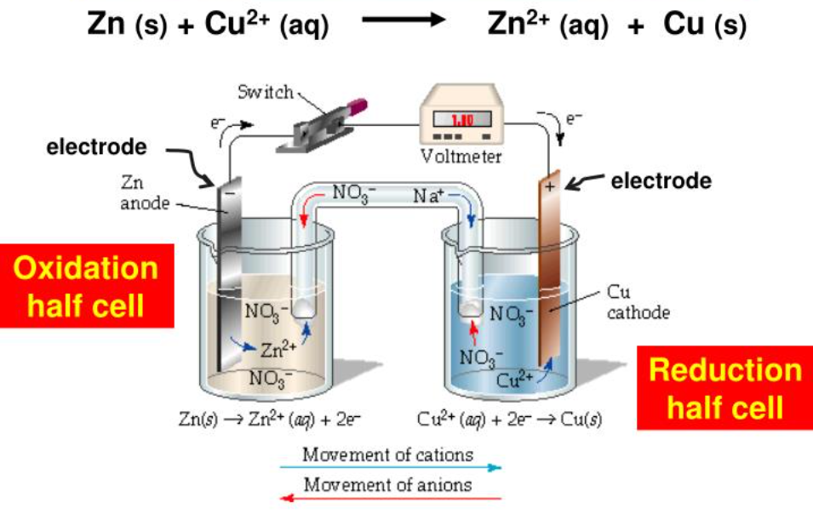


Slide 8



Slide 9
Uses:
Because galvanic cells can be self-contained and portable, they can be used as batteries and fuel cells.
A battery is a galvanic cell that contains all the reactants needed to produce electricity.
In contrast, a fuel cell is a galvanic cell that requires a constant external supply of one or more reactants to generate electricity.

Slide 10
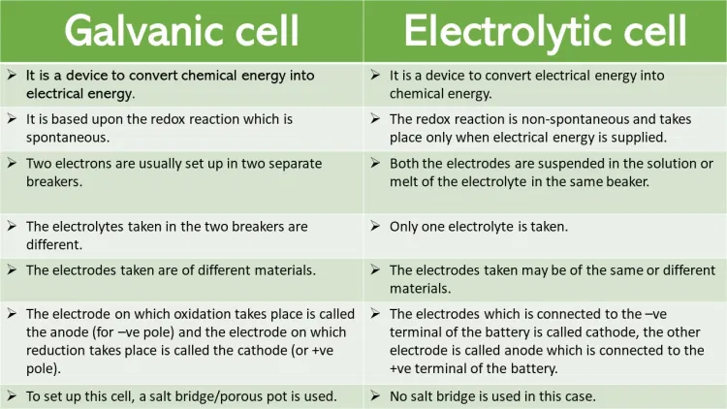
electrodes

Slide 11



